Slide 1



X
Predictive Analysis of Good vs. Bad Borrowers Using Logistic Regression, Random Forest, and XGBoost
ID/X Partners - Data Scientist
Presented by
Rakhmadiani Ardinda Chaerunnisa

Slide 2



Rakhmadiani Ardinda Chaerunnisa
I am a Data Science student in theFaculty of Information Technology and Data Science (FATISDA) at Universitas Sebelas Maret with a strong passion for Data, Machine Learning, and Artificial Intelligence.
I have contributed to research on optimizing Random Forest for rainfall prediction. I also have experience as a Master of Ceremony for events with over 200 attendees
LinkedIn

Slide 3
Experiences
Achievements
Master of Ceremony for the
Seminar “Preparation and Coaching
for Competitions
Universitas Sebelas Maret
January 2025
3rd Place Outstanding Student in the Faculty of Information Technology and Data Science (FATISDA) 2025
January 2025
Awardee of FATISDA Organizational Excellent
Awards
Universitas Sebelas Maret
December 2024
Assistant Lecturer of Statistics for Data Science
Universitas Sebelas Maret
October 2024 – December 2024
1st Place National Statistics Data Analysis
Sebelas Maret Statistic Fair
November 2024
Master of Ceremony Grand Closing
Sekolah Mawapres
Universitas Sebelas Maret
March 2024
2nd Author of a SINTA 4-Indexed Journal on
Operating Systems
Universitas Sebelas Maret
October 2024
Master of Ceremony Grand Opening
Sekolah Mawapres
Universitas Sebelas Maret
February 2024

Slide 4

About Company
id/x partners was established in 2002 by ex-bankers and management consultants who have vast experiences in credit cycle and process management, scoring development, and performance management. Our combined experience has served corporations across Asia and Australia regions and in multiple industries, specifically financial services, telecommunications, manufacturing and retail.
id/x partners provides consulting services that specializes in utilizing data analytic and decisioning (DAD) solutions combined with an integrated risk management and marketing discipline to help clients optimize the portfolio profitability and business process.
Comprehensive consulting service and technology solutions offered by id/x partners makes it as a one-stop service provider.

Slide 5
Project Portfolio
The dataset used, titled “Load Data 2007 – 2014”, contains consumer information such as the loan amount requested by borrowers, the actual amount approved and funded, loan interest rates, installment amounts per period, annual borrower income, the debt-to-income ratio, and many other features. The goal is to improve the accuracy of credit risk assessment and management by classifying consumers into Good and Bad borrowers based on the Loan Status variable. This classification also considers payment history to determine whether borrowers make timely payments. To achieve this, a predictive model is built using Logistic Regression, Random Forest, and XGBoost algorithms in Python.
Link code here!
Project explanation video here!

Slide 6
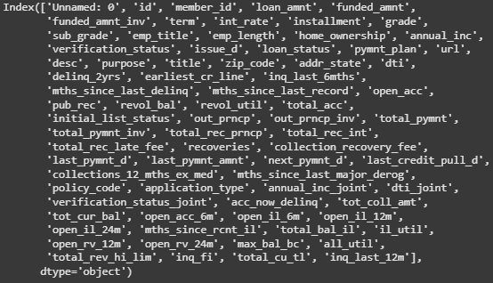
Data Understanding
Dataset Structure
The dataset consists of 466285 rows and 75 columns, and there is no duplication in the data. The columns are:

Slide 7
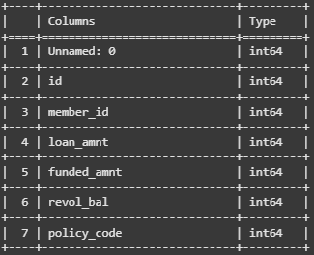
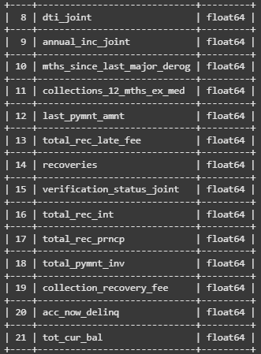
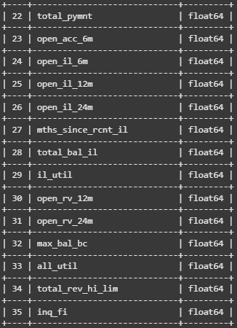
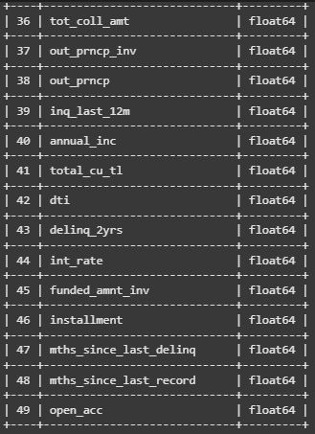
b. Data Type

Slide 8
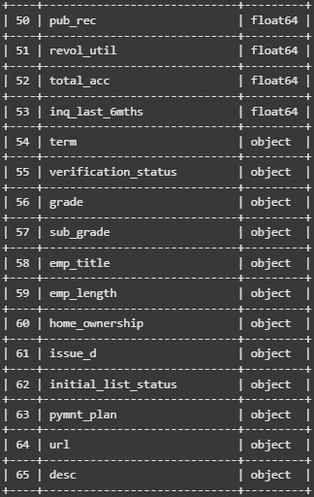
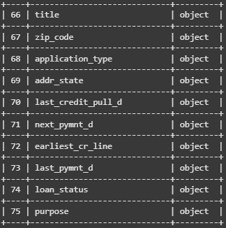
b. Data Type

Slide 9
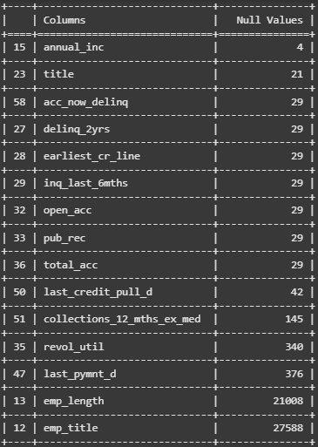
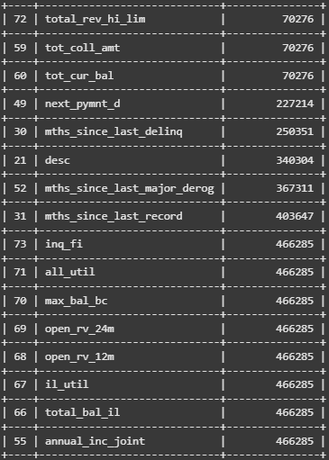
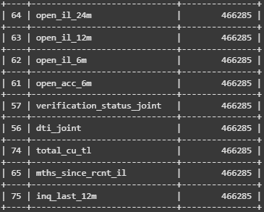
Data Understanding
c. Identify Missing Values
Before analyzing descriptive statistics and variable distribution, first identify whether there are
any missing values.

Slide 10
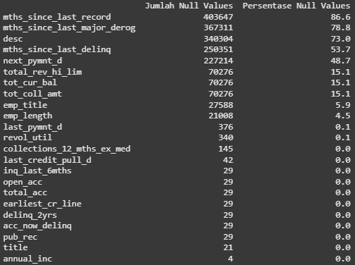
Data Understanding
d. Handling Missing Values
The classification of missing values handling is as follows:
1). If an entire column consists of null values, drop the column. This is the result after dropping
columns that contain only null values.

Slide 11
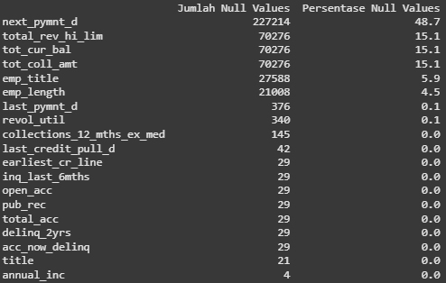
Data Understanding
d. Handling Missing Values
2). If missing values exceed 50% of the dataset, drop the column. The result is:

Slide 12

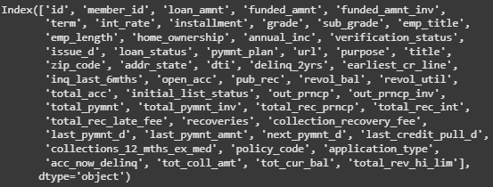
Data Understanding
d. Handling Missing Values
3). If missing values are less than 50% of the dataset, perform imputation:
- For numerical data, use the mean.
- For categorical data, fill with the most frequent value in each column.
The result is that no columns have missing values anymore.
After handling missing values, the dataset consists of 466285 rows and 53 columns.
The columns are:

Slide 13
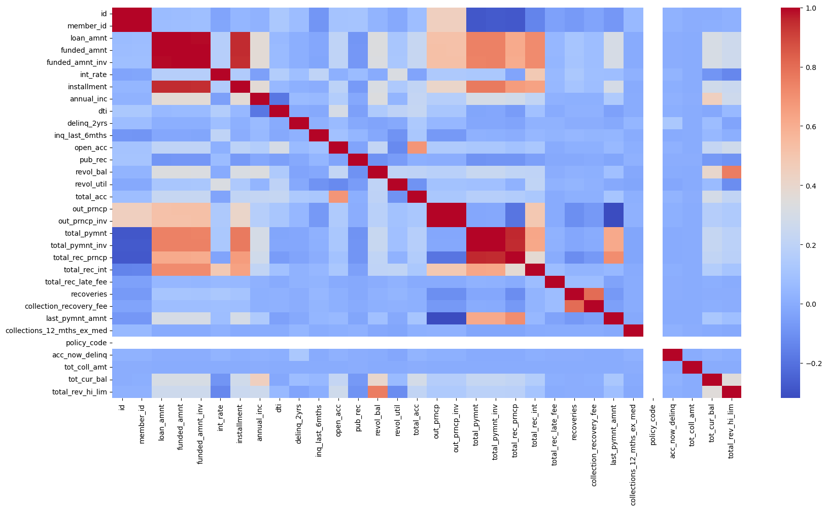
Exploratory Data Analysis
a. Correlation Between Numeric Variables

Slide 14
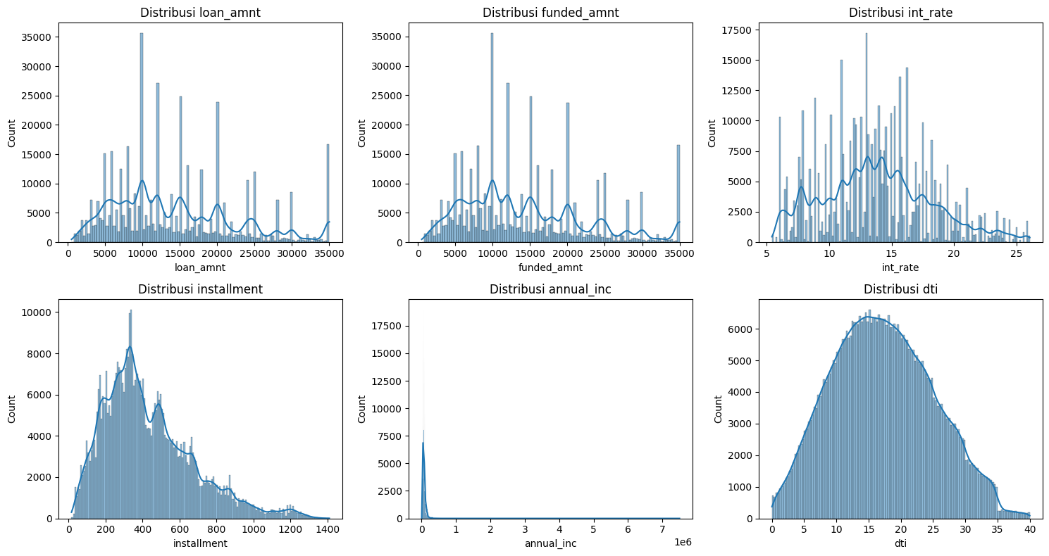
Exploratory Data Analysis
b. Visualization of Key Numeric Variables (consisting of "loan_amnt", "funded_amnt", "int_rate", "installment", "annual_inc", and "dti’)

Slide 15
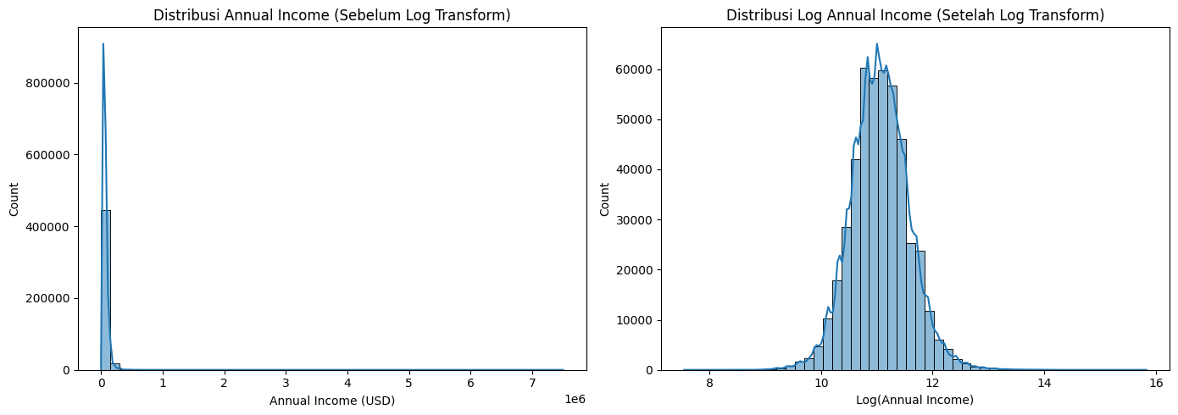
Exploratory Data Analysis
c. Solutions for Non-Normally Distributed Data (Annual Income Column)

Slide 16
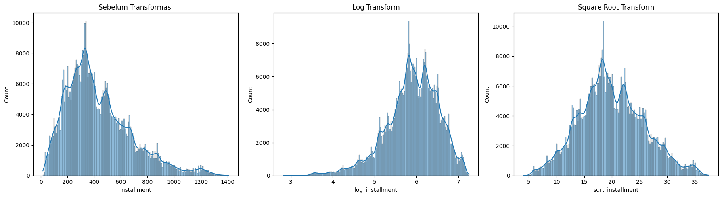
Exploratory Data Analysis
c. Solutions for Non-Normally Distributed Data (Installment Column)

Slide 17
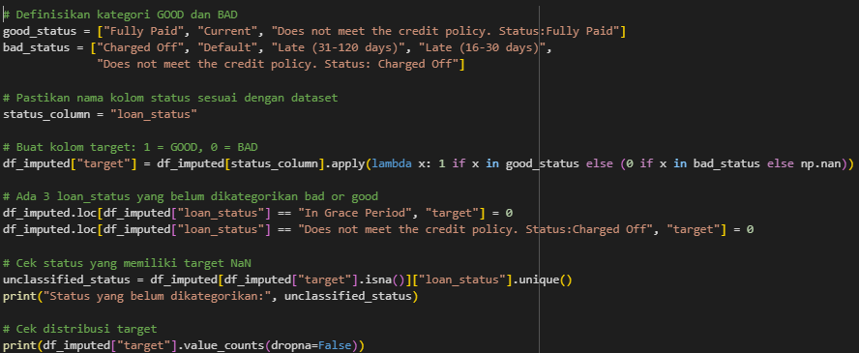
Exploratory Data Analysis
d. Split the data into two categories based on loan status: Good and Bad in the target column
A Good status is when the loan status is "Fully Paid", "Current", or "Does not meet the credit policy. Status:Fully Paid“, while a Bad status is when the loan status is"Charged Off", "Default", "Late (31-120 days)", "Late (16-30 days)", "In Grace Period“, or "Does not meet the credit policy. Status:Charged Off“. Good will be represented by 1, and Bad by 0.
The dataset contains 410.953 Good Borrowers and 55.332 Bad Borrowers.

Slide 18
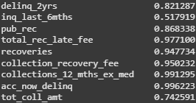
Exploratory Data Analysis
e. Handling Data with Many Zero Values
1). Identify numeric columns where more than 50% of the values of 0

Slide 19
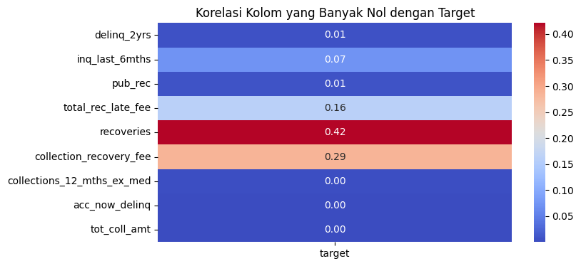
Exploratory Data Analysis
e. Handling Data with Many Zero Values
2). Check the correlation with the target:
- if the correlation is more than 0.1 -> Important (Apply transformation or categorization)
- If the correlation is less than 0.05 -> Not Important (Drop the column)
Remove columns: "delinq_2yrs", "pub_rec", "collections_12_mths_ex_med", "acc_now_delinq", and "tot_coll_amt"

Slide 20
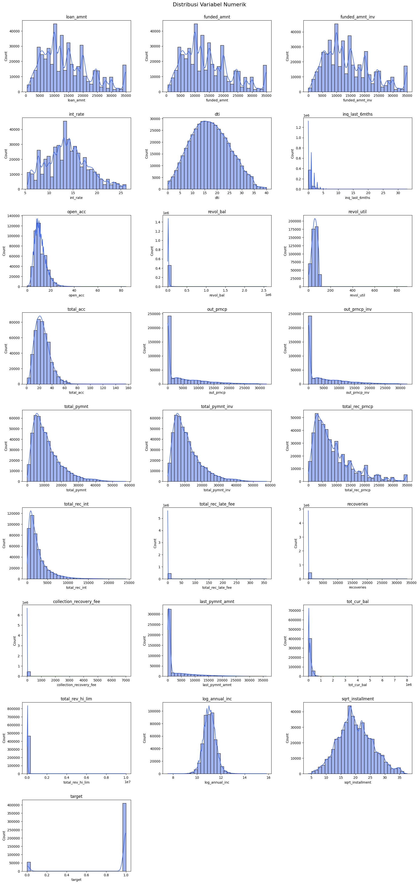
Exploratory Data Analysis
f. Updated Visualization of Numeric Variables

Slide 21
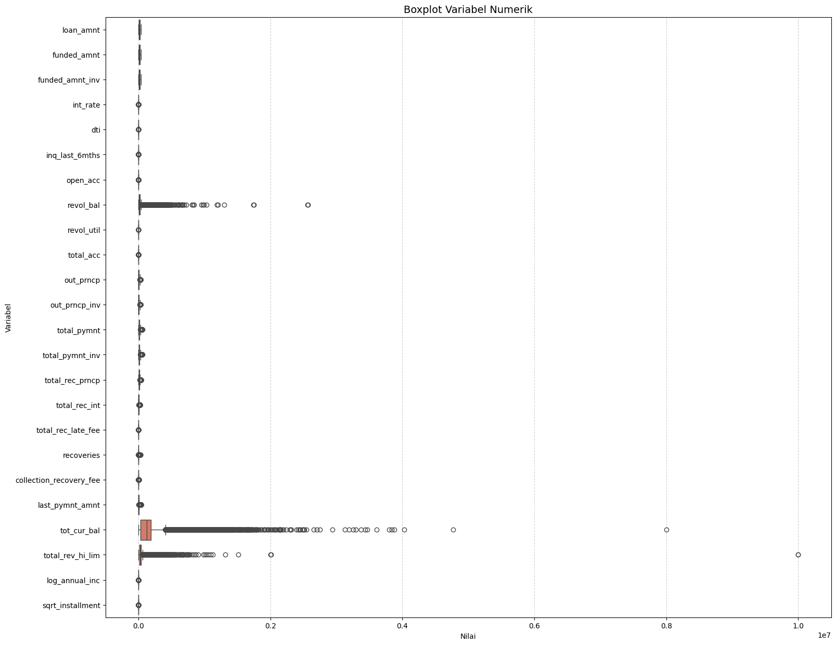
Exploratory Data Analysis
g. Visualization of Numeric Variables

Slide 22
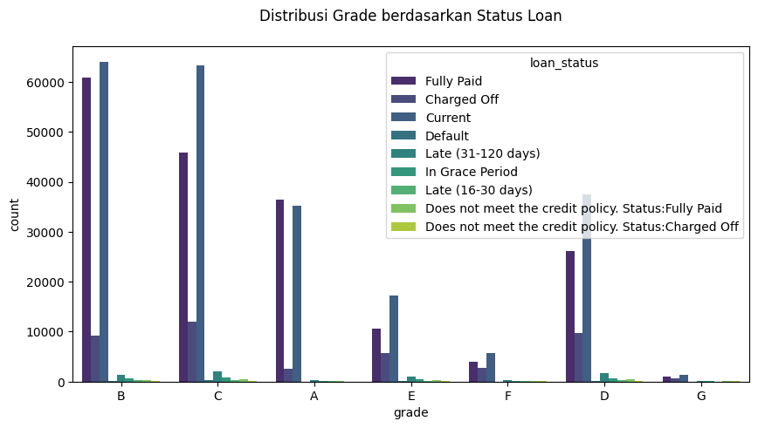
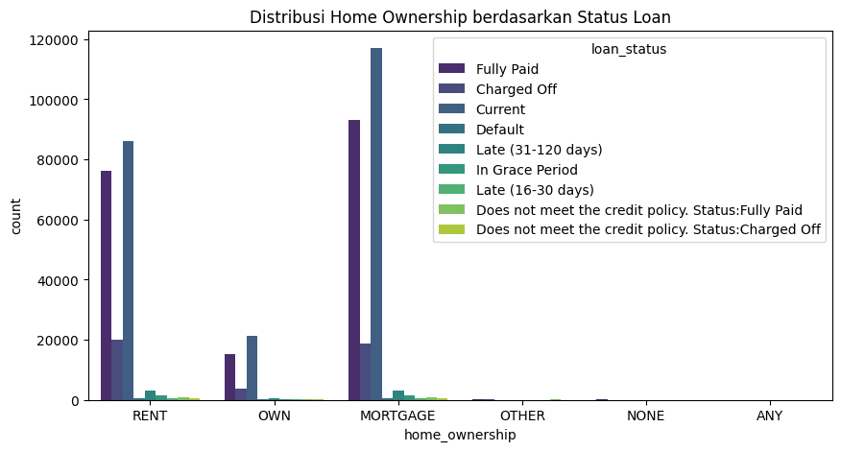
Exploratory Data Analysis
g. Visualization of Categoric Variables

Slide 23
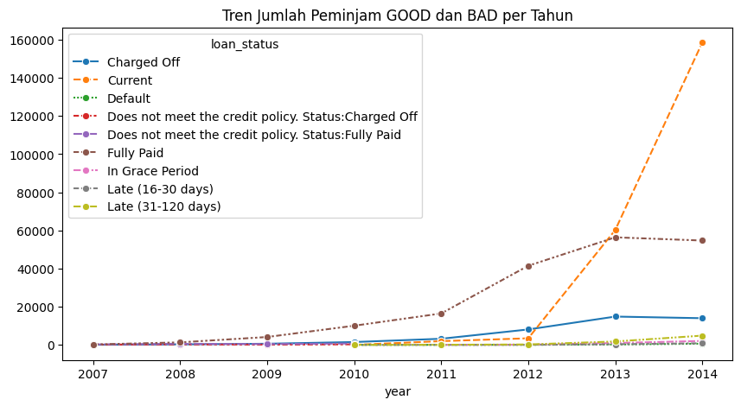
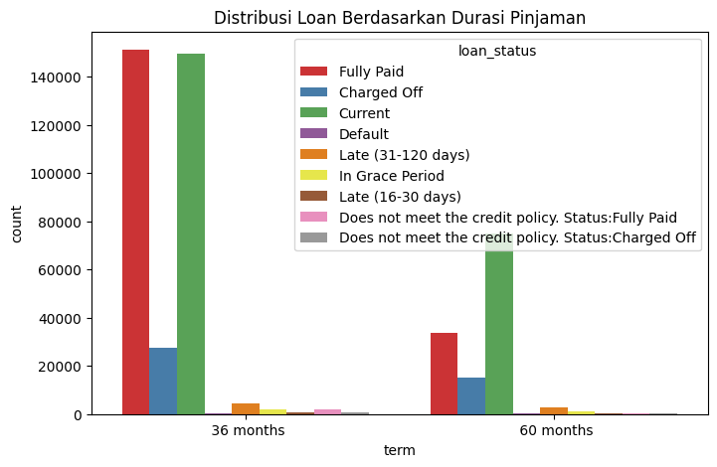
Exploratory Data Analysis
g. Visualization of Categoric Variables

Slide 24
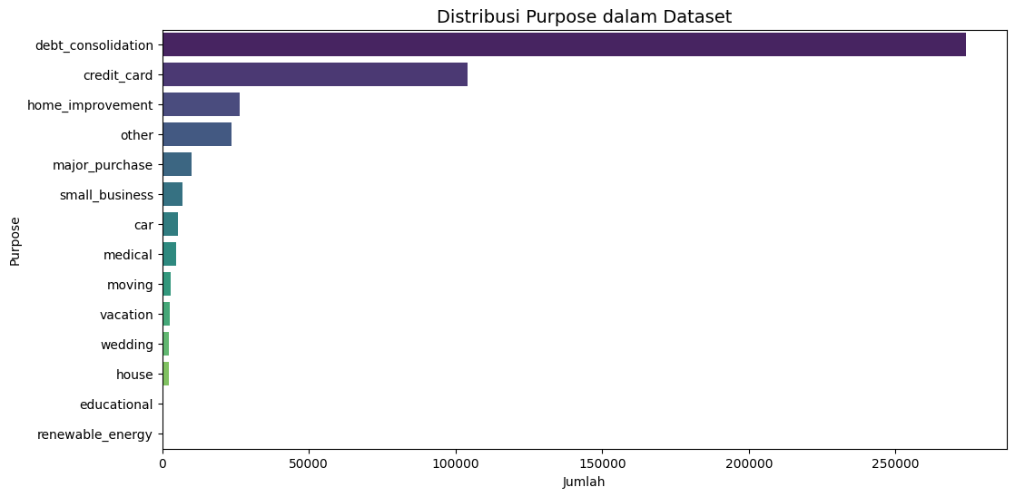
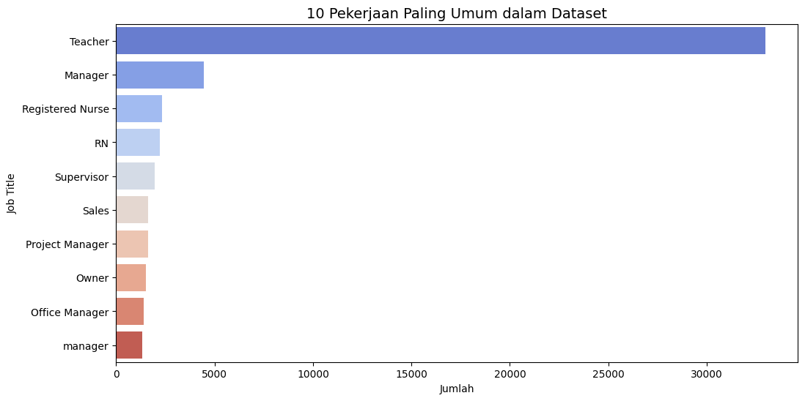
Exploratory Data Analysis
g. Visualization of Categoric Variables

Slide 25
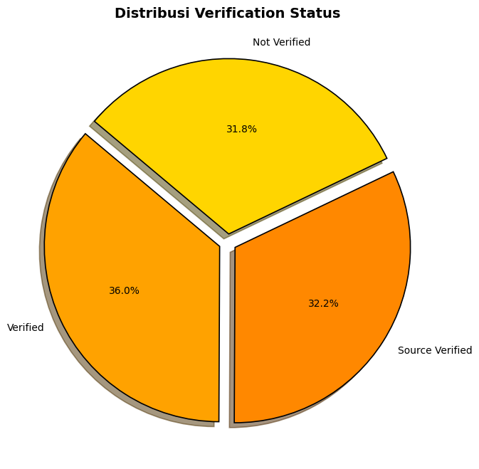
Exploratory Data Analysis
g. Visualization of Categoric Variables

Slide 26
Data Preparation
Encoding Categorical Variables
Before starting label encoding, select the columns to be used again. At this stage, I removed
the "zip_code" and "url" columns as they are not needed.
Perform ordinal encoding for categories with an inherent order, such as "grade" and
"emp_length". Apply one-hot encoding for unordered categorical variables like "home_ownership", "verification_status", "purpose", "application_type", "initial_list_status",
and "pymnt_plan". Use binary encoding for columns with a high number of unique values,
such as "emp_title", "addr_state", and "title". Convert date columns to Unix timestamps for
"issue_d", "earliest_cr_line", "last_pymnt_d", "next_pymnt_d", and "last_credit_pull_d"
The following columns are generated after label encoding, resulting in more columns than
before.

Slide 27
Data Preparation
b. Split Data Into Train and Test
Before splitting the data into train and test sets, separate the feature columns and the target
variable by removing the "target" column from the features.
Then, split the data into 80% training data and 20% testing data. Set ‘stratify = y’ in the code to
ensure that the proportion of Good and Bad classes remains balanced.

Slide 28
Data Preparation
c. Scaling or Normalization
This step ensures that all features in X_train and X_test are converted to numeric values and preprocessed properly before being used in a machine learning model. The steps are as follows:
1). Convert All Columns to Numeric
Each column in X_train and X_test is converted to a numeric data type using pd.to_numeric().
The parameter errors='coerce' ensures that any non-numeric values are replaced with NaN (Not a Number).
2). Handling Missing Values (Imputation of NaN)
If NaN values exist after conversion, the SimpleImputer method from scikit-learn is used to replace them.
The chosen strategy is mean, meaning NaN values in each column will be replaced with the column’s average value.
fit_transform() is applied to X_train, while X_test uses transform() to maintain consistency with the training data.

Slide 29
Data Preparation
c. Scaling or Normalization
3). Standardizing the Data (Scaling)
After converting all values to numeric and handling NaNs, the data is normalized using StandardScaler.
StandardScaler transforms each feature to have a mean of 0 and standard deviation of 1, improving model stability and training speed.
fit_transform() is applied to X_train, and transform() is applied to X_test to ensure the same scaling distribution.

Slide 30
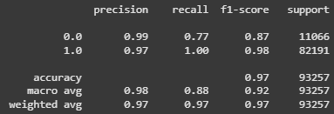
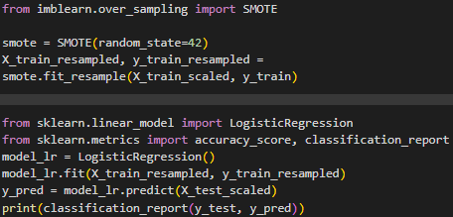
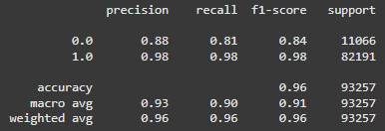
Data Modeling
a. Train the Model
1. Logistic Regression
- First Try Result
This model is imbalanced (class 1 is much more prevalent than class 0), and it may be biased toward the majority class. Perform data resampling using SMOTE to increase the minority class samples. New model after SMOTE:
ROC-AUC Score: 0.959637523388209

Slide 31
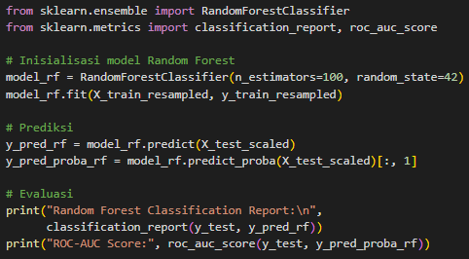
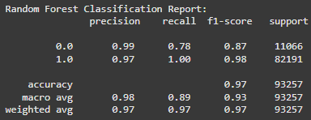
Data Modeling
a. Train the Model
2. Random Forest
ROC-AUC Score: 0.9645866842148038

Slide 32
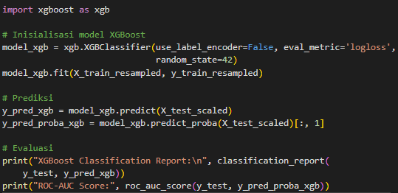
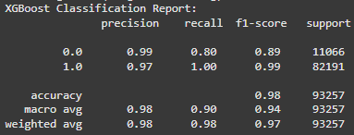
Data Modeling
a. Train the Model
3. XGBoost
ROC-AUC Score: 0.9705869341956712

Slide 33
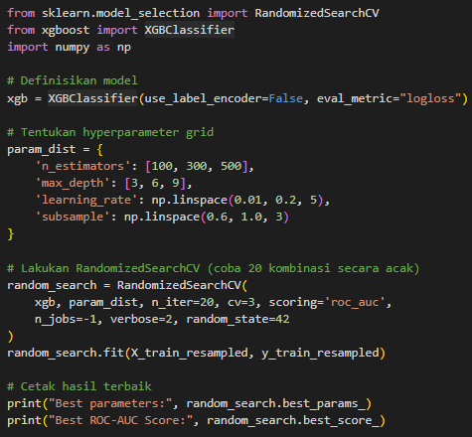
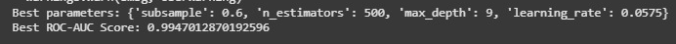
Data Modeling
b. Find the Best Model Parameters
The best model is XGBoost with a ROC-AUC of 0.97. Therefore, I performed hyperparameter tuning using Random Search Cross Validation, which resulted in the following optimal parameters:

Slide 34
Evaluation and Conclusion
Model | Accuracy | Recall (0.0) | Recall (1.0) | ROC-AUC
Logistic Regression | 97% | 0.77 | 1.00 | -
Logistic Regression + SMOTE | 96% | 0.81 | 0.98 | 0.9596
Random Forest | 97% | 0.78 | 1.00 | 0.9646
XGBoost | 98% | 0.80 | 1.00 | 0.9706
XGBoost (Tuned) | 99% | - | - | 0.9947
XGBoost after tuning is the best model because: - The ROC-AUC drastically increased to 0.9947, demonstrating the model's excellent ability to distinguish between GOOD and BAD borrowers.
- Accuracy increased to 99%.
- Hyperparameter tuning helped optimize the model further.

Slide 35
Thank You
X
Logo Company

